Slide 1


Forecasting a Stock Price
Forecasting a Stock Price using Linear Models such as Linear Regression, K-Nearest Neighbor(KNN), Support Vector Machine(SVM) and using RNN-LSTM as a Time Series Forecasting Model.

Slide 2
Having an Edge
A short understanding of my interpretation of the market psyche.
Why should we try to predict a stock price?
Traders and Investors alike want to maximize profit while minimizing risks. In order to do that they often use forecasting tools as indicators which enables them to try and make accurate market predictions.
The Modeling Aspect
Predictive models are not always but are often applied as short-term indicators. Many models are available in Machine Learning which can serve as stock market forecasting tools. What we must understand is no models can take the place of good governance over money management. Here however in my Advanced Data Science Capstone Project I would like to see how a few Machine Learning predictive models work in comparison to a stock’s actual price performance. My goal is to submit a Linear Regression model, a K-Nearest Neighbor model, a Support Vector Machine model and a RNN-LSTM Time Series Forecasting model using the company Amazon.com stock’s historical price data.

Slide 3
Presenting Four Predictive Models
Linear Regression Model - Linear regression makes an attempt at modeling the relationship between two variables by fitting a linear equation to observed data where one variable is considered to be an explanatory variable and the other is considered to be a dependent variable. It is the most basic and commonly used type of predictive analysis.
K-Nearest Neighbor (KNN) Model - KNN is a supervised learning classification and regression algorithm that uses nearby points in order to generate a prediction. It is said to be one of the most basic yet essential classification algorithms in Machine Learning.
Support Vector Machine(SVM) model - SVM is a supervised machine learning model that can be used for classification and regression. SVM is effective in high dimensional spaces. It is effective in cases where the number of dimensions is greater than the number of samples. It is memory efficient and is versatile.

Slide 4
Presenting Four Predictive Models
RNN-LSTM Time Series Forecasting model
RNN stands for recurrent neural network. LSTM stands for long short-term memory. Since time series prediction problems are difficult types of predictive modeling problems, recurrent neural networks are used in deep learning to train very large architectures successfully.

Slide 5
Initial Data Exploration
I will be using the historical price data of Amazon.com which goes by the ticker AMZN and it trades on the NASDAQ.
Data is scraped using the yahoo.finance API from the financial site of yahoo.com
Working with AMAZON.COM
Total data set starts '2009-04-01' ends '2021-03-31'(3020,7)
Train data set starts '2009-04-01' ends '2018-03-31'(1812,7)
Test data set starts '2018-04-01' ends '2021-03-31'(755,7)
validation data is set at 20 percent (453,7)

Slide 6
ETL
Historical data price on Amazon.com starting date 2009-04-01, ending date 2021-03-31
 | Open | High | Low | Close | Volume | Dividends | Stock Splits
Date
2009-04-01 | 73.019997 | 75.089996 | 71.709999 | 73.500000 | 7041400 | 0 | 0
2009-04-02 | 73.629997 | 77.239998 | 73.440002 | 76.339996 | 11066900 | 0 | 0
2009-04-03 | 76.419998 | 78.320000 | 75.500000 | 78.169998 | 5809900 | 0 | 0
2009-04-06 | 77.260002 | 78.360001 | 76.000000 | 77.989998 | 5751300 | 0 | 0
2009-04-07 | 76.970001 | 77.080002 | 74.879997 | 75.510002 | 5748800 | 0 | 0

Slide 7
Clean Data Set
 | Date | Open | High | Low | Close | Volume
0 | 2009-04-01 | 73.019997 | 75.089996 | 71.709999 | 73.500000 | 7041400
1 | 2009-04-02 | 73.629997 | 77.239998 | 73.440002 | 76.339996 | 11066900
2 | 2009-04-03 | 76.419998 | 78.320000 | 75.500000 | 78.169998 | 5809900
3 | 2009-04-06 | 77.260002 | 78.360001 | 76.000000 | 77.989998 | 5751300
4 | 2009-04-07 | 76.970001 | 77.080002 | 74.879997 | 75.510002 | 5748800

Slide 8
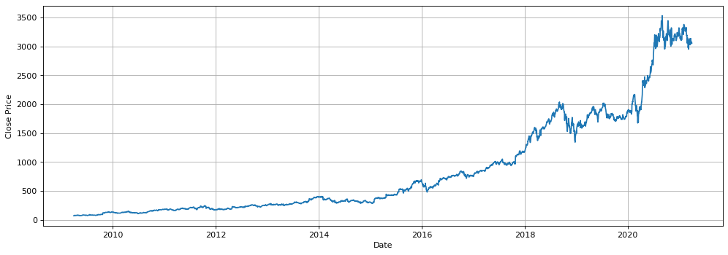
Visualizing Amazon price chart

Slide 9
Feature Engineering - Exploratory Data Analysis
Measuring Correlation:
The range of value for Pearson Correlation is between -1 to 1. It is a popular way of measuring for correlation. If two features are positively correlated then they are directly proportional and if they are negatively correlated then they are inversely proportional. The correlation is high.
 | Open | High | Low | Close | Volume
Open | 1.000000 | 0.999892 | 0.999852 | 0.999742 | -0.097273
High | 0.999892 | 1.000000 | 0.999819 | 0.999871 | -0.094226
Low | 0.999852 | 0.999819 | 1.000000 | 0.999882 | -0.101377
Close | 0.999742 | 0.999871 | 0.999882 | 1.000000 | -0.097886
Volume | -0.097273 | -0.094226 | -0.101377 | -0.097886 | 1.000000

Slide 10
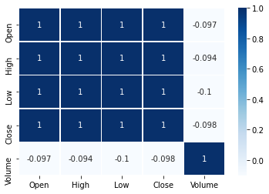
Plotting Correlation for better understanding
Let us use the Pearson Correlation Map to better understand feature correlation which is high.

Slide 11
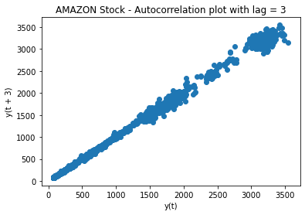
Plot Cross-correlation

Slide 12
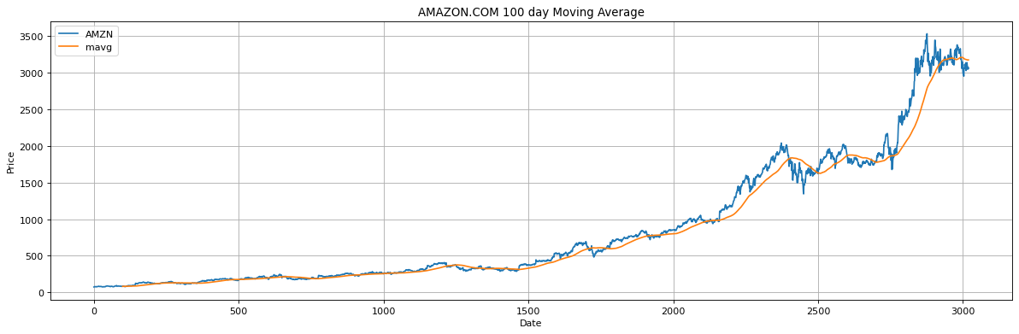
The Rolling Mean (Moving Average)
Moving average helps us smooth out data that has a lot of fluctuation and helps us see the long term trend better.

Slide 13
Model Definition
Reshape the Data for Linear Models: Linear Regression, K-Nearest Neighbor(KNN), Support Vector Machine(SVM)
The volume feature is removed because it is not the focus of this project.
 | Date | Open | High | Low | Close
0 | 2009-04-01 | 73.019997 | 75.089996 | 71.709999 | 73.500000
1 | 2009-04-02 | 73.629997 | 77.239998 | 73.440002 | 76.339996
2 | 2009-04-03 | 76.419998 | 78.320000 | 75.500000 | 78.169998
3 | 2009-04-06 | 77.260002 | 78.360001 | 76.000000 | 77.989998
4 | 2009-04-07 | 76.970001 | 77.080002 | 74.879997 | 75.510002

Slide 14
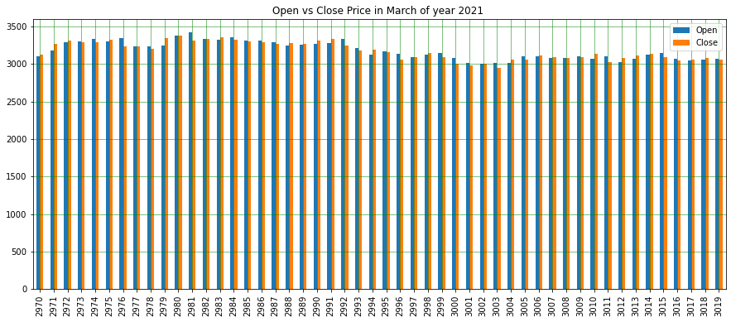
Open price vs the Close price
The official open price is at 9.30am and the closing is at 4pm.

Slide 15
Feature Engineering – Date Format
To avoid errors the Date format will be changed to separate Year, Month, Day
Presenting data.tail which reflects the more recent amzn price ticks.
 | Day | Month | Year | High | Open | Low | Close
3015 | 24 | 3 | 2021 | 3160.310059 | 3151.040039 | 3085.149902 | 3087.070068
3016 | 25 | 3 | 2021 | 3109.780029 | 3072.989990 | 3037.139893 | 3046.260010
3017 | 26 | 3 | 2021 | 3056.659912 | 3044.060059 | 2996.000000 | 3052.030029
3018 | 29 | 3 | 2021 | 3091.250000 | 3055.439941 | 3028.449951 | 3075.729980

Slide 16
Splitting the data into train and test sets
(3020, 6) Total data set
(3020,)
(2265, 6) Train data set
(2265,)
(755, 6) Test data set
(755,)

Slide 17
Model Training
Please refer to notebooks for details.
For the Linear Regression and the KNN models a cross-valuation for accuracy is performed.
Cross-Validation is a technique where the model is evaluated on a dataset on which it is not trained. It can be the test data or another dataset.
Linear Regression Cross-Validation
Accuracy: 99.99998687063808
KNN Cross-Validation
Accuracy: 99.97465262168085

Slide 18
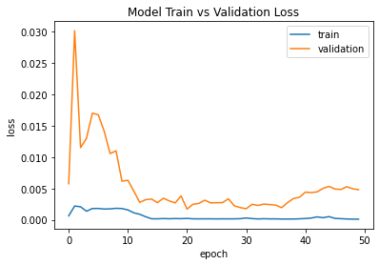
Model Training
For RNN-LSTM Model a plot of loss of train vs validation was performed. It shows a slight underfit.

Slide 19
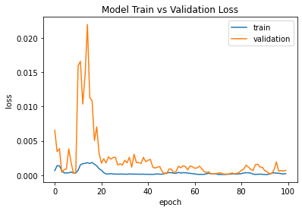
Model Training
My question is how can I improve the RNN-LSTM model's performance?
After many trials and errors of different types of compiling, I doubled the number of epochs to 100. The result of a better fit of Model train vs validation loss over epoch.

Slide 20
For Part 2 of This Presentation
Click Part2

